Slide 1
Microcalcification detection, clustering and features extraction
Presentation of 09/08/2023
Notes: Thoses slides aren’t so developped because of the short period since the last meeting ( 2 days) and the presentation has been mainly on the codes and outputs of the code

Slide 2
I) Background, reminder of last meeting
II) Ordering
III) Making a csv table
IV) Trying new datasets
Dicoms and PNG format
InBreast
DDSM

Slide 3
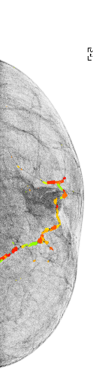
I) Background, reminder of last meeting
Last time :
Starting to clean the code and making the extract functions for Elisaveth and George
New python metrics, study of clustering parameters
Advances on extracting matlab features
New datasets
Settled objectives :
Keep cleaning the code (own settled)
Other datasets (Inbreast, ddsm)
Adapt the extract functions to the expect format of Elisaveth and Georges
Other objectives (available on the Github ) haven’t been treated yet because of time
Clusters from last time using Inbreast dataset (solution 2)

Slide 4
II) Ordering
-2 pythons functions :
-> new_core.py : loading img, pre-treatment, and MC detection
-> auxiliar_function.py : Post-treatment, metrics, clustering, plots, formating, saving
Show python

Slide 5
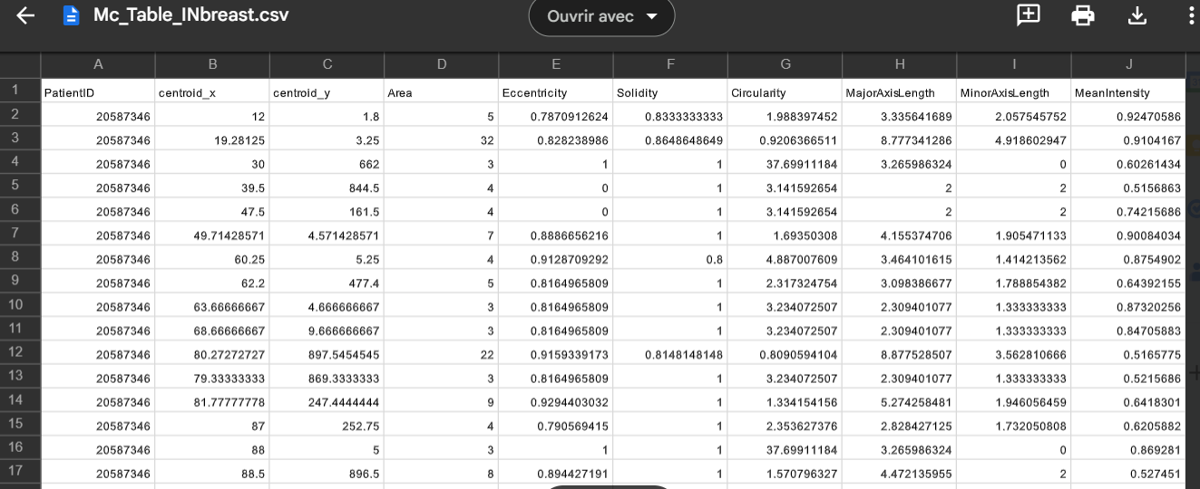
III) Making a csv table
Show jupyter

Slide 6
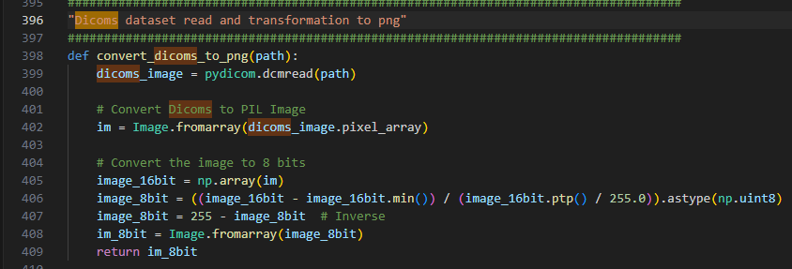
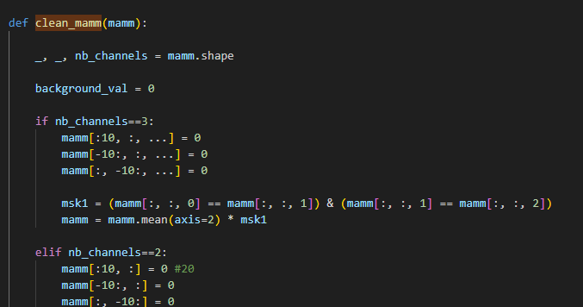
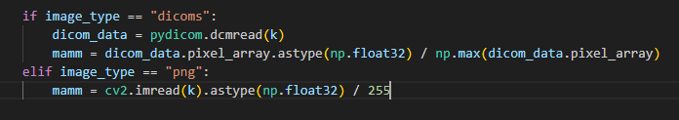
IV) Trying new datasets
Show jupyter and python
1) Dicoms and PNG format
Converting dicoms to png
Using dicoms as an entry of Calc1

Slide 7
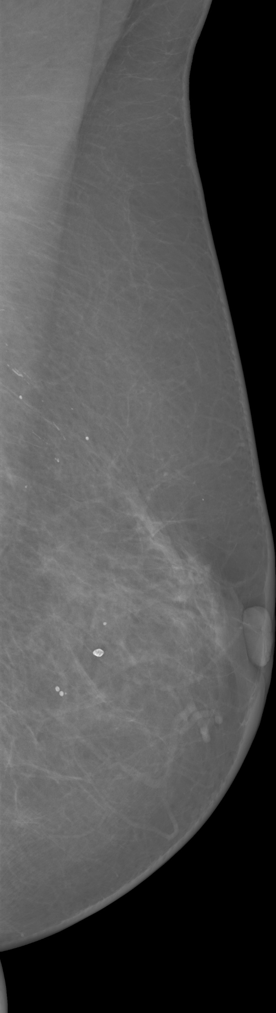
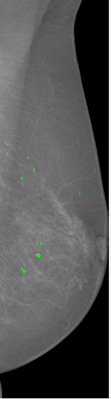
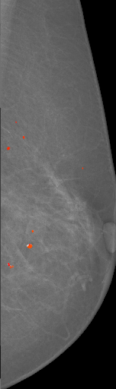
2) INbreast
Show jupyter and GUI

Slide 8
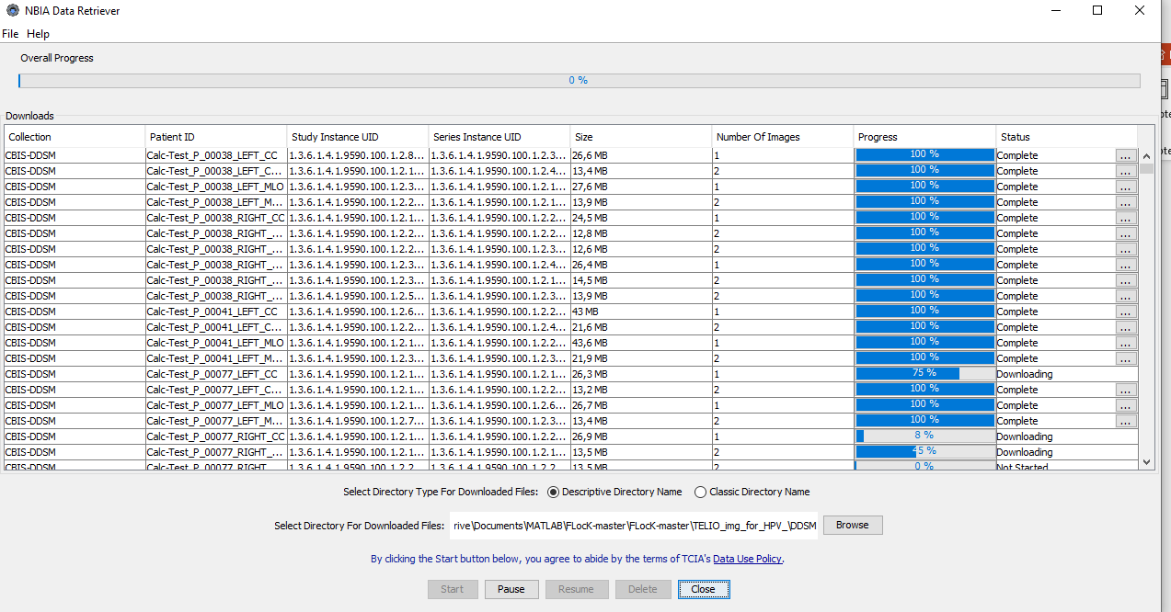
3) DDSM
Show NBIA Data Retriever
- NBIA program crashes a few times, problems of size (160+GB): 1% in 1h30

